Slide 1
Alcoholic Classification Using Body Signals
George Washington University
Instructor: Prof. David W. Trott
Course: Machine Learning
Presentation by
Sai Prathyusha Kanisetti

Slide 2
Agenda
Introduction.
Description of the Dataset.
Pre-Processing.
Outlier Detection and Removal.
Exploratory Data Analysis.
SMART Questions
Model Building.
Conclusion.

Slide 3
Introduction
Excessive drinking pose significant health challenges in society today. Understanding these behavioral patterns and implications is crucial for public health interventions. The Smoking and Drinking Dataset with Body Signal provides a valuable resource for exploring the relationship between these behaviors and various body signals.

Slide 4
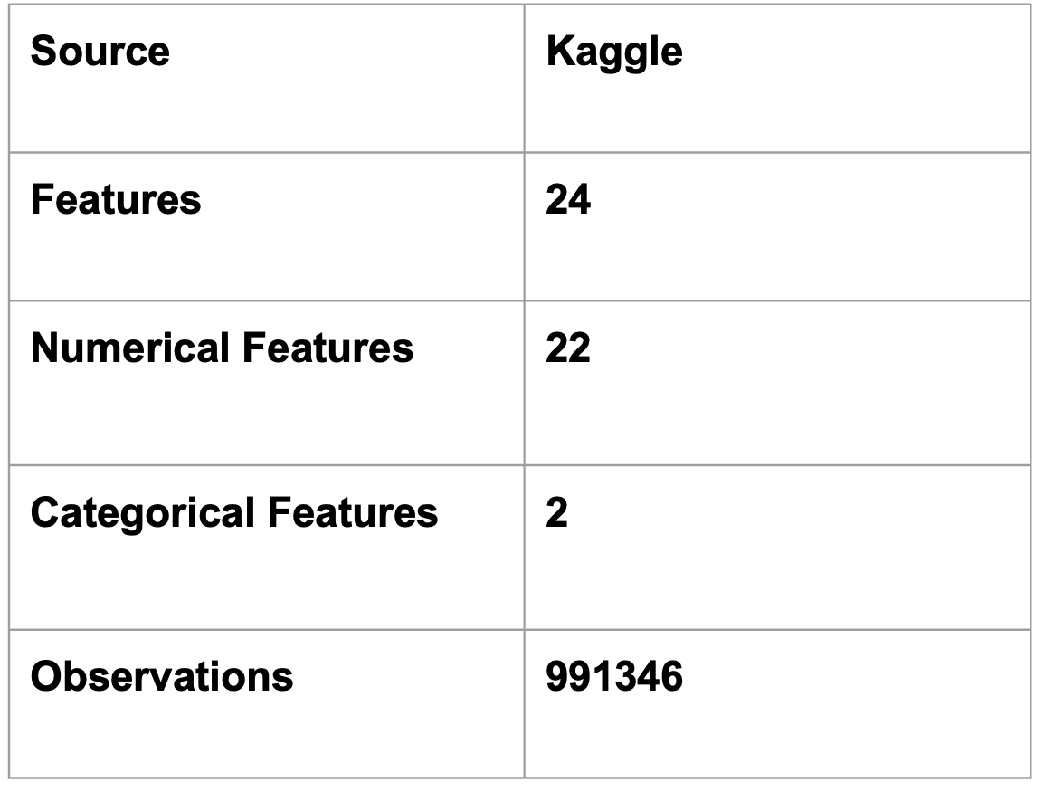
Description of the Dataset

Slide 5
Data Dictionary
Acronyms | Definition
SBP | Systolic Blood Pressure
DBP | Diastolic Blood Pressure
BLDS | Fasting Blood Glucose Level
HDL_chole | High Density Level Cholesterol
LDL_chole | Low Density Level Cholesterol
SGOT_AST | Aspartate Aminotransferase
SGOT_ALT | Alanine Transferase
Gamma_GTP | Gamma-Glutamyl Transpeptidase

Slide 6
Data Preprocessing
Removing Duplicates
Duplicate Rows | 26
Observation: We've identified 26 duplicate entries in the dataset. Removing these duplicates will ensure cleaner data for our analysis and model building. However, given that the number is relatively small, their impact on the analysis or model outcomes is likely to be minimal.

Slide 7
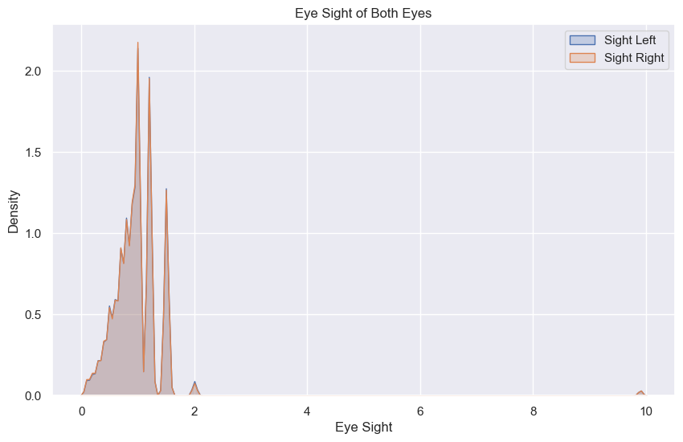
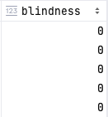
Data Preprocessing
Feature Engineering

Slide 8
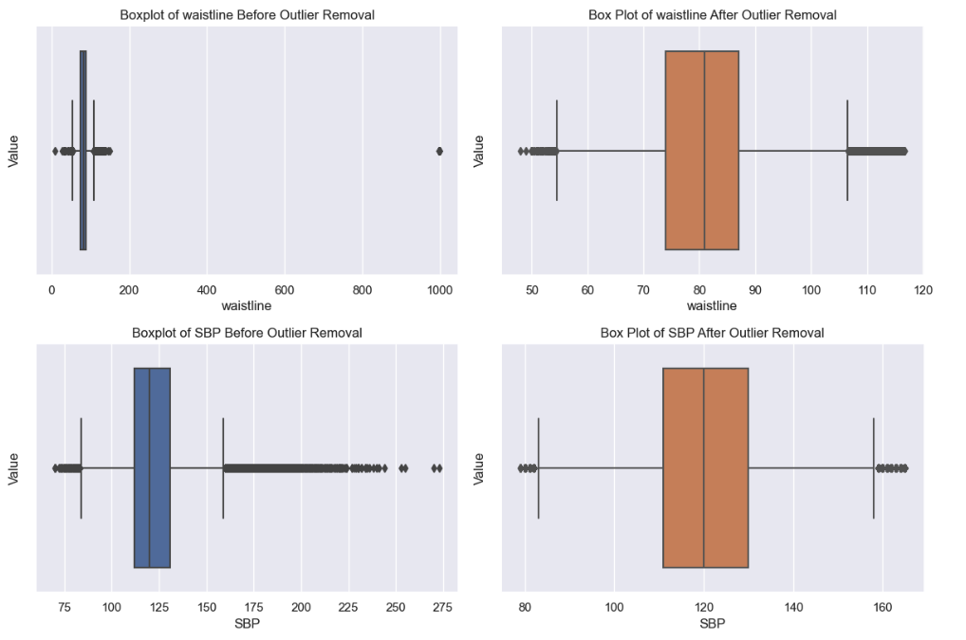
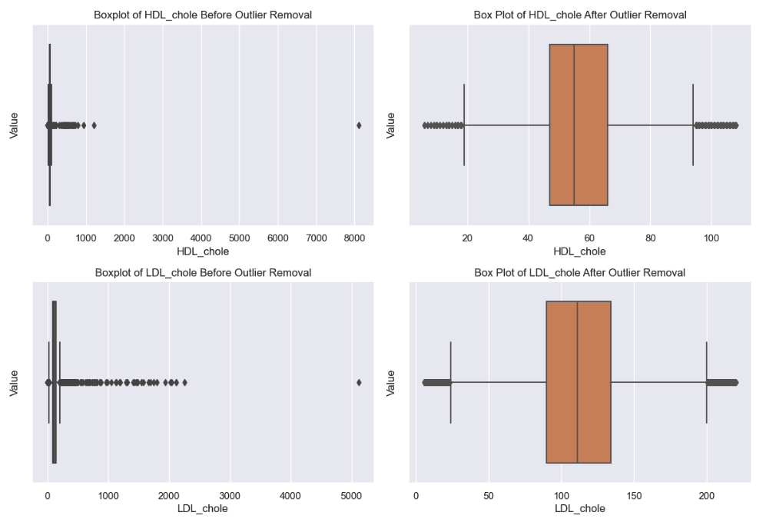
Outlier Analysis and Removal

Slide 9
Outlier Analysis and Removal
Before Outlier Removal | After Outlier Removal
991346 | 906676
After removing outliers from our dataset, the total number of observations decreased from 991,346 to 906,676, indicating a substantial cleanup.

Slide 10
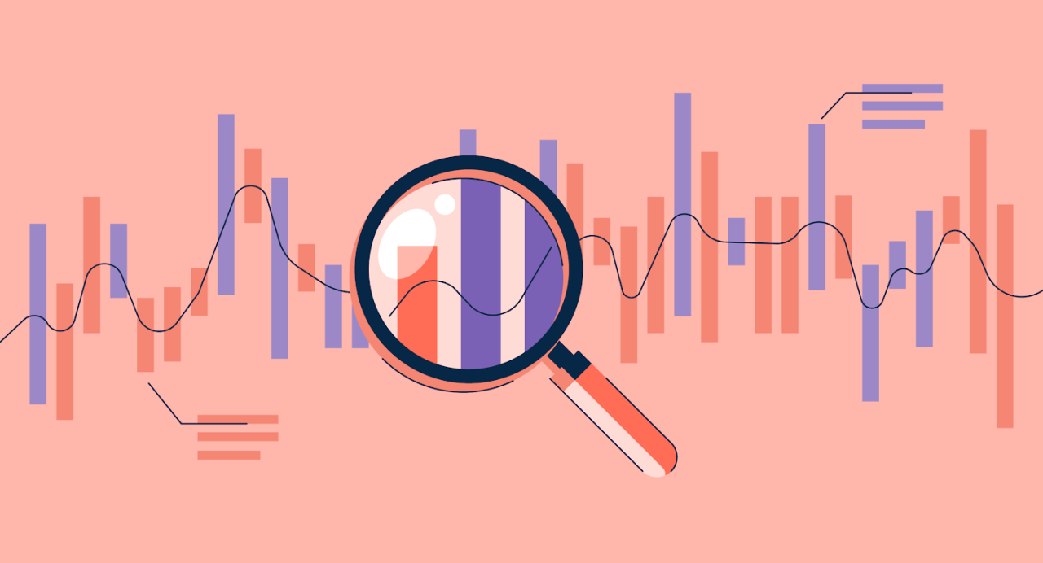
Exploratory Data Analysis

Slide 11
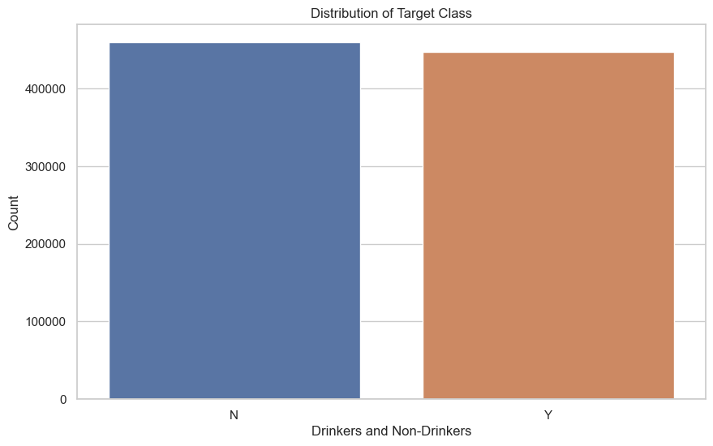
Target Class Distribution
Observation:
From analyzing the bar plot, we can conclude that the distribution between drinkers and non-drinkers is roughly equal. This indicates that there is no significant skew towards either group in our dataset.

Slide 12
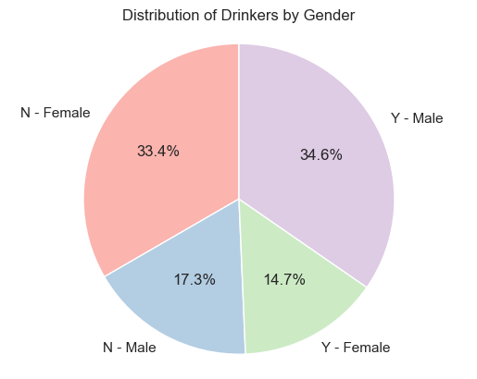
Distribution of Drinkers/Non-Drinkers By Gender
Drinker (Yes/No) | Gender | Count
No | Female | 302439
No | Male | 156971
Yes | Female | 133160
Yes | Male | 314106

Slide 13
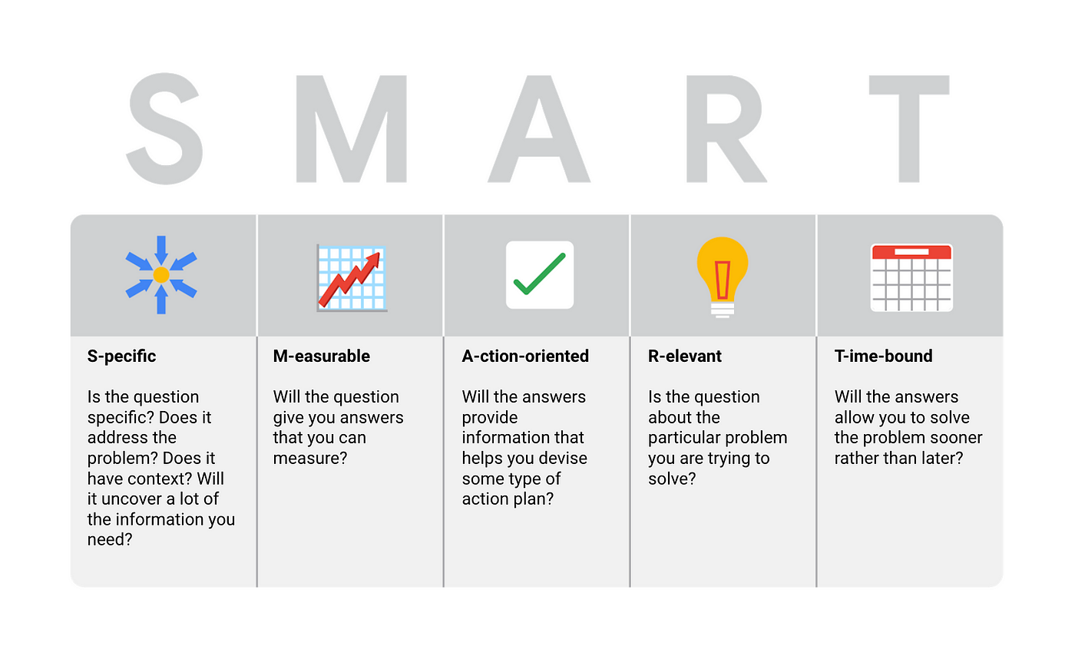
SMART Questions

Slide 14
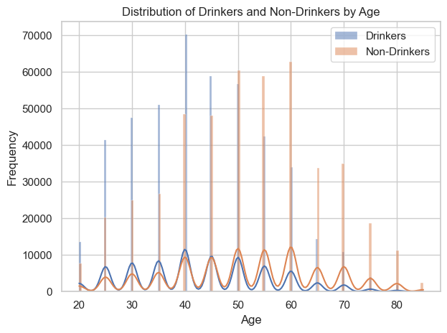
Which age group is most habituated with drinking alcohol ?
Observation:
The data shows that younger and middle-aged people tend to drink alcohol more than older people. This interesting trend related to age makes us want to explore further if social reasons or differences between generations influence how people approach drinking.

Slide 15
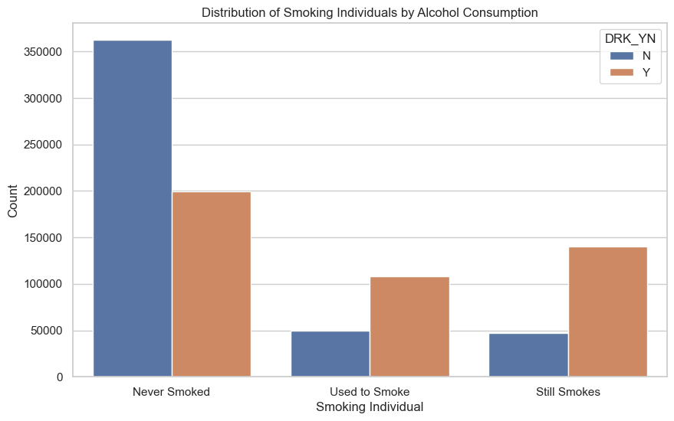
2. Does every individual who drinks follow smoking trend ?
Observation:
Individuals who have never smoked are twice as likely to drink alcohol compared to those who neither smoke nor drink.
Individuals who previously smoked and currently drink outnumber those who used to smoke but do not drink by two to one.
Individuals who currently smoke and drink are twice as numerous as those who smoke but do not drink.

Slide 16
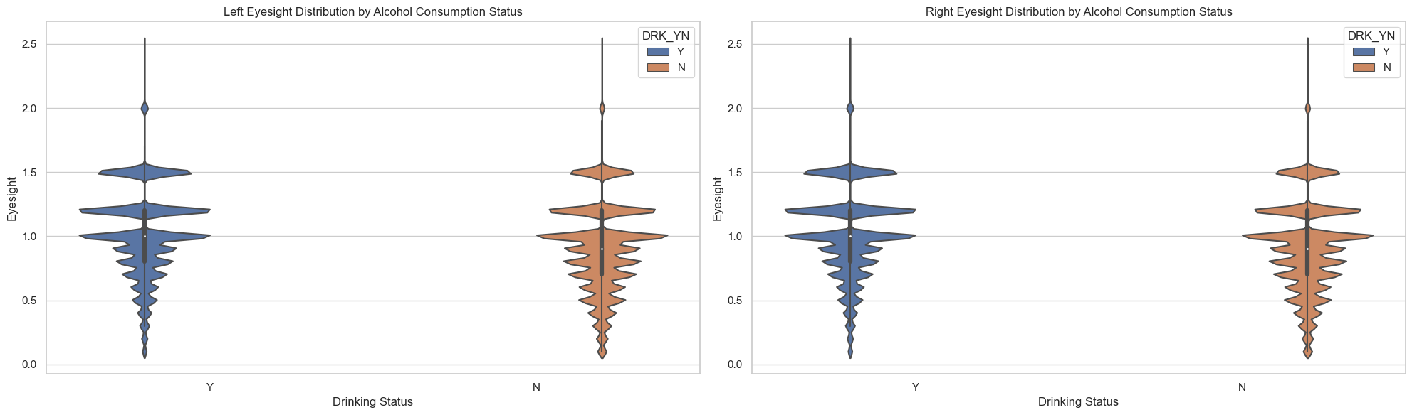
3. Is there any significant impact of alcohol on eyesight ?

Slide 17
Normality Check and Hypothesis Test
Normality Check
Left Eye
Right Eye
Mann Whitney U Test
Left Eye
Right Eye
Statistics: 0.967 | P: 0.0
Statistics: 0.976 | P: 0.0
Statistics: 83126118542 | P: 0.0
Statistics: 83310640173 | P: 0.0

Slide 18
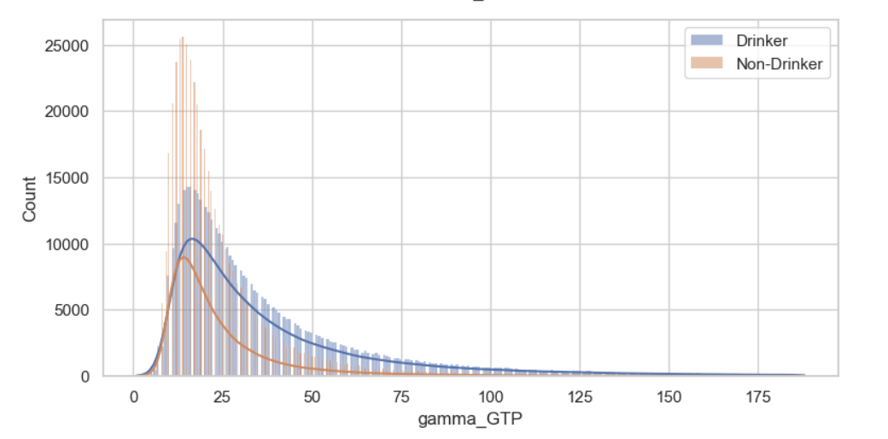
4. Does drinking alcohol regularly affect the liver ?
Observation:
Elevated gamma-GTP levels among participants who consume alcohol indicate significant liver damage due to alcohol consumption.

Slide 19
Feature Importance
SET 1
gamma_GTP
HDL_chole
age
SMK_stat_type_cd
serum_creatinine
sex_Female
SGOT_ALT
SBP
weight
sex_Male
height
SGOT_AST
SET 2
age
height
weight
sight_left
sight_right
SBP
DBP
BLDS
tot_chole
HDL_chole
triglyceride
hemoglobin
serum_creatinine
SGOT_AST
SGOT_ALT
gamma_GTP
SMK_stat_type_cd
sex_Female
sex_Male

Slide 20

Model Building

Slide 21
Random Forest

Slide 22
Random Forest Classifier
SET 1
SET 2
Accuracy | 0.725
Precision | 0.721
Recall | 0.719
F1 Score | 0.720
ROC AUC | 0.725
Accuracy | 0.728
Precision | 0.724
Recall | 0.724
F1 Score | 0.724
ROC AUC | 0.728

Slide 23
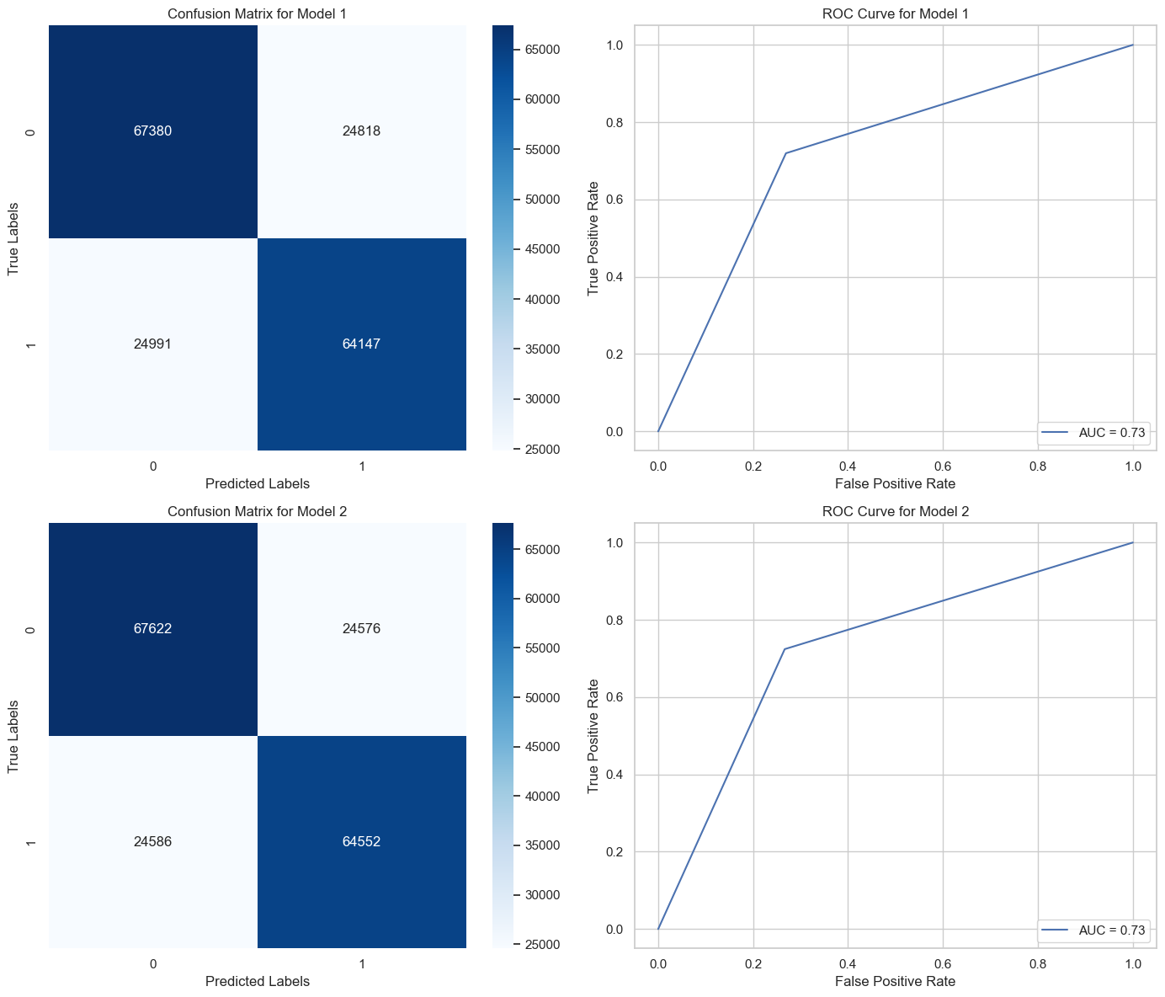
Confusion Matrix and AUC-ROC Curve

Slide 24
Gradient Boosting

Slide 25
Gradient Boosting
SET 1
SET 2
Accuracy | 0.729
Precision | 0.718
Recall | 0.740
F1 Score | 0.729
ROC AUC | 0.730
Accuracy | 0.730
Precision | 0.718
Recall | 0.741
F1 Score | 0.749
ROC AUC | 0.730

Slide 26
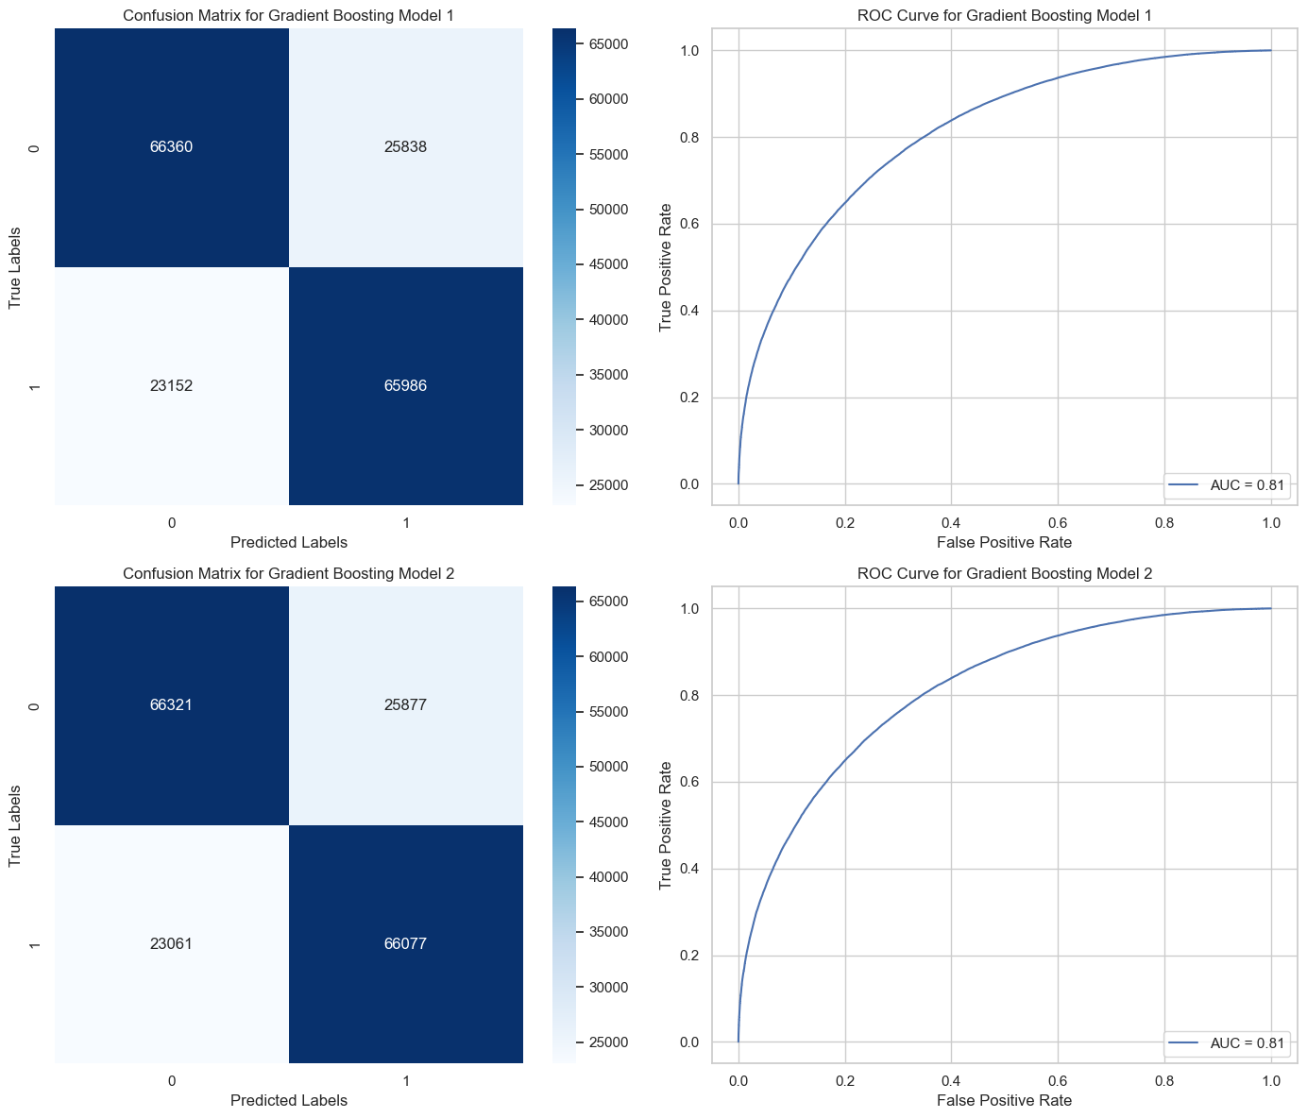
Confusion Matrix and AUC-ROC Curve

Slide 27
XGBoost

Slide 28
XGBoost
SET 1
SET 2
Accuracy | 0.732
Precision | 0.726
Recall | 0.731
F1 Score | 0.729
ROC AUC | 0.732
Accuracy | 0.734
Precision | 0.728
Recall | 0.732
F1 Score | 0.730
ROC AUC | 0.734

Slide 29

Confusion Matrix and AUC–ROC Curve

Slide 30
K- Fold Cross Validation
Fold 1 | 0.733
Fold 2 | 0.733
Fold 3 | 0.734
Fold 4 | 0.735
Fold 5 | 0.736
Mean CV Score | 0.734
Standard Deviation | 0.00094

Slide 31
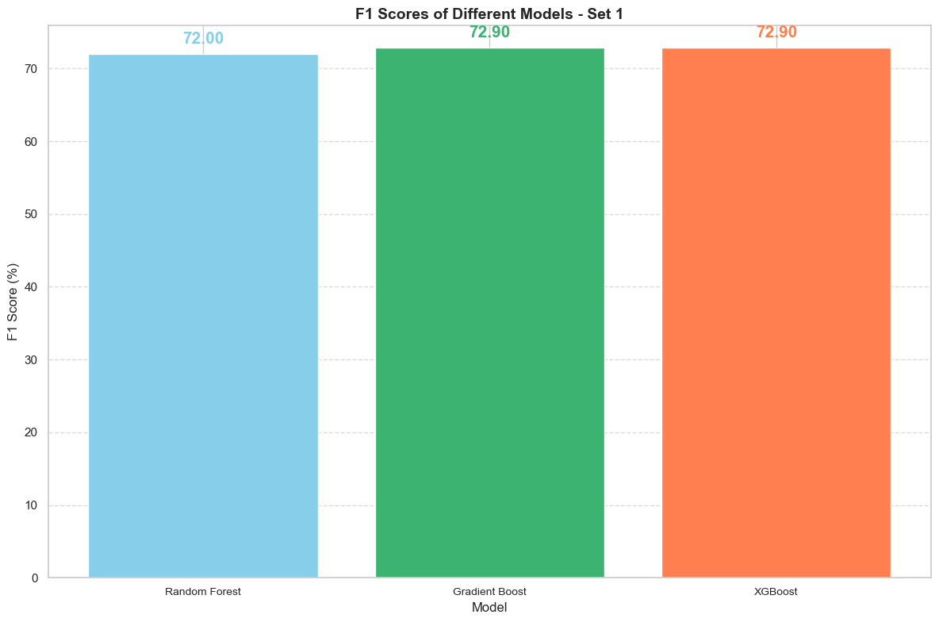
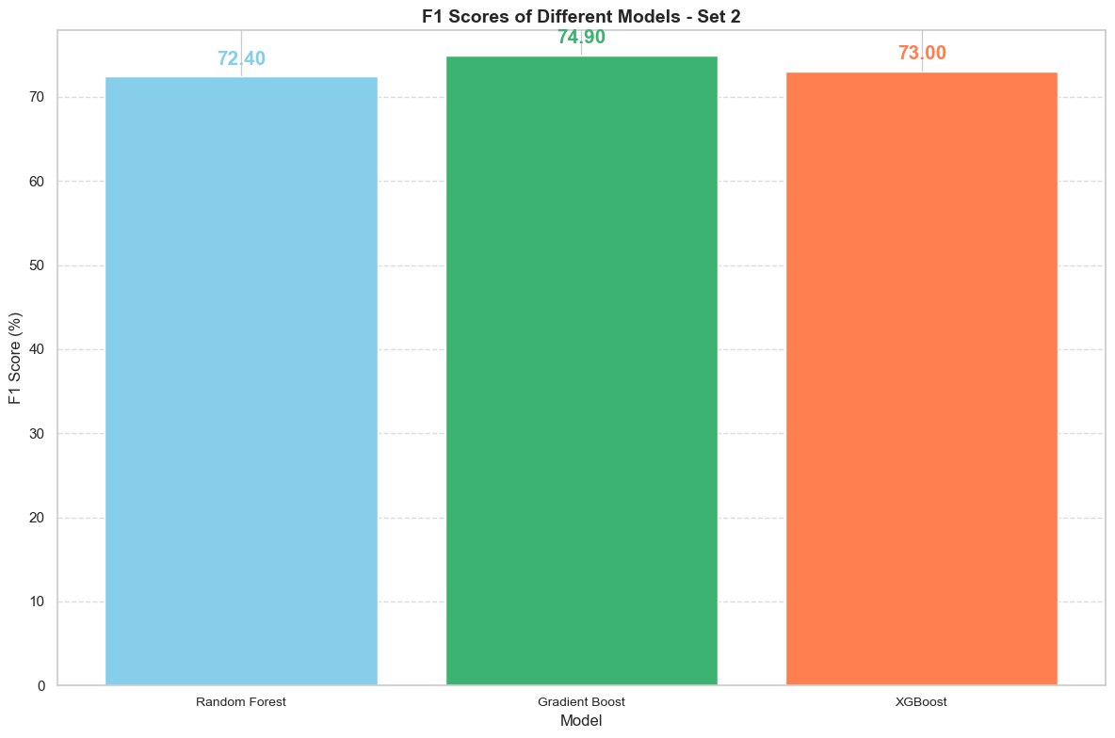
F1 Metric Comparison

Slide 32
Conclusion
In summary, XGBoost is a powerful choice for structured data tasks due to its transparency, efficiency, and flexibility. It provides clear insights into feature importance, crucial in fields like healthcare and finance.
Additionally, XGBoost is resource-efficient, making it cost-effective for organizations with smaller to medium-sized datasets.

